Slide 1
Data driven testing tool
- Ameya Sukthankar
Deepak Soni
Mahesh Veerabathiran

Slide 2
Todays agenda
Testing approaches
Use Case for Demo
Challenges
Proposed Solution
Service Virtualization
JVM Cucumber
Benefits of the tool
Demo
Q&A

Slide 3


testing approaches
Tedious
Time Consuming
Repetitive
Unpredictable
Cost Reduction
Efficient regression testing
Consistent
Reusable
Significantly faster

Slide 4
old testing approach
Product Owner discusses business scenarios with developer
Developer writes automated test cases using java cucumber
Product owner reviews test result
Release code if results are good
Product owner thinks of new scenarios

Slide 5
use case for demo
API to calculate mortgage loan eligibility
Calls external API to get credit score from Trans Union /Equifax
Calls backend API to calculate loan rate.
Credit Report API
Client
Mortgage Loan API
Loan Rate Calculator API

Slide 6

Challenges
Cumbersome/
Redundancy
Developer involvement every time end user wants to add/modify a scenario
Rework every time there is a change in scenario.
Difficult to set up data for external services

Slide 7

new testing approach
Product owner discusses business scenarios with developer
Developer writes automated test cases using java cucumber
End user reviews test result
Release code if results are good
Product owner thinks of new scenarios
Product owner puts all scenarios
in excel sheet

Slide 8




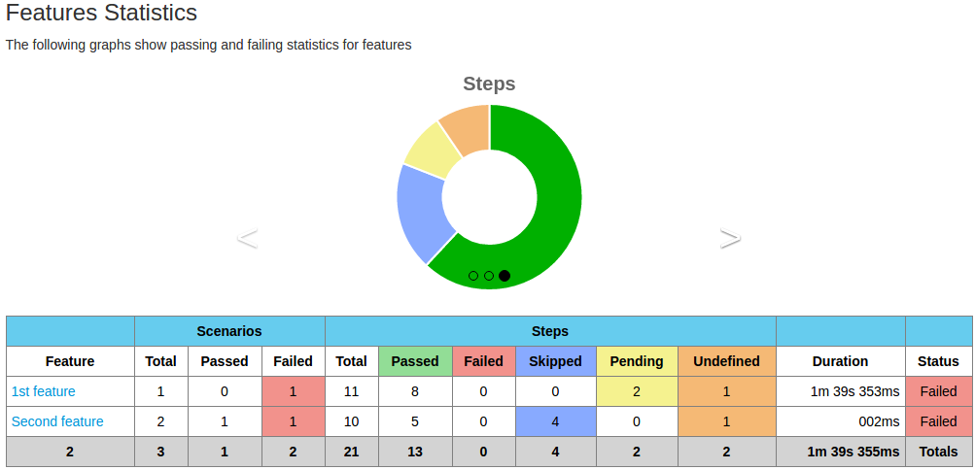

Step 1: Product owner populates test scenarios in an excel sheet
Step 2: All backend Integration services are virtualized with the data given in spreadsheet
Step 3: Customized JVM-Cucumber framework to parse test metrics from Spreadsheet &validate the API against it.
Step 4: Testing results are captured during execution and publish interactive reports using cucumber report plugin
Notes:
Add link to virtualization excel sheet

Slide 9
Service Virtualization
Emulate behavior of dependent components in applications
Service virtualization allows teams to :
Work safely in isolation
Shift testing to the left and discover defects earlier
Introduce & test new functionality in a controlled manner
Virtualize unavailable but dependent components
Enables frequent and comprehensive testing
Tools – HP SeV, Parasoft, Wiremock, Hoverfly etc.
Notes:
As application development trend towards more composite, service oriented architecture approaches, service virtualization should be applied at or between any layer where dependencies exist to provide with more realistic or live like environment.

Slide 10
Service virtualization
Parasoft features that we utilized for our tool:
Use Service Contract/ Blueprints as Inputs to creating Virtual service:
REST API – Swagger/RAML specification
SOAP Services – WSDL/XML schema
Create the test environment we need on demand
Test extensively with broad array of conditions instantly
Record web traffic and database queries to be virtualized
Data Sources for parameterized data driven testing
API for management of test suite & virtual projects.
Easy Integration in continuous pipeline
Notes:
RESTful API Modeling Language
Swagger Specification
Web Service Definition Language

Slide 11

SERVICE VIRTUALIZATION
Data Source
Excel
Server
Credit Report API Virtual Asset
Data
Source
Mortgage Loan API
Push
to Server
Loan Rate Calculator Virtual Asset

Slide 12
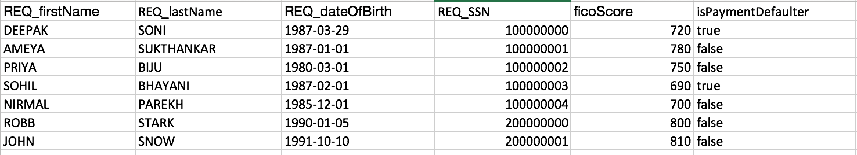
Credit Report API Virtual Asset
Virtual Service URL:
Query Parameters:
http://localhost:9080/v2/customers/credit-info?
firstName=DEEPAK&lastName=SONI&dateOfBirth=19870329&SSN=100000000
Request
{
"ficoScore": "720",
"isPaymentDefaulter": true
}
Response:

Slide 13
JVM Cucumber – Quick overview
Cucumber-JVM is an open source tool.
It is based on BDD tool that let you define executable test code in business facing text.
The test written in Cucumber-JVM has two parts, business facing text and glue code.
Business facing test are written in Gherkin, supports over 60 spoken languages to define your business facing text.
Glue code can be written in Java. Cucumber also supports glue code in other programming languages such as Ruby, Scala, Groovy

Slide 14
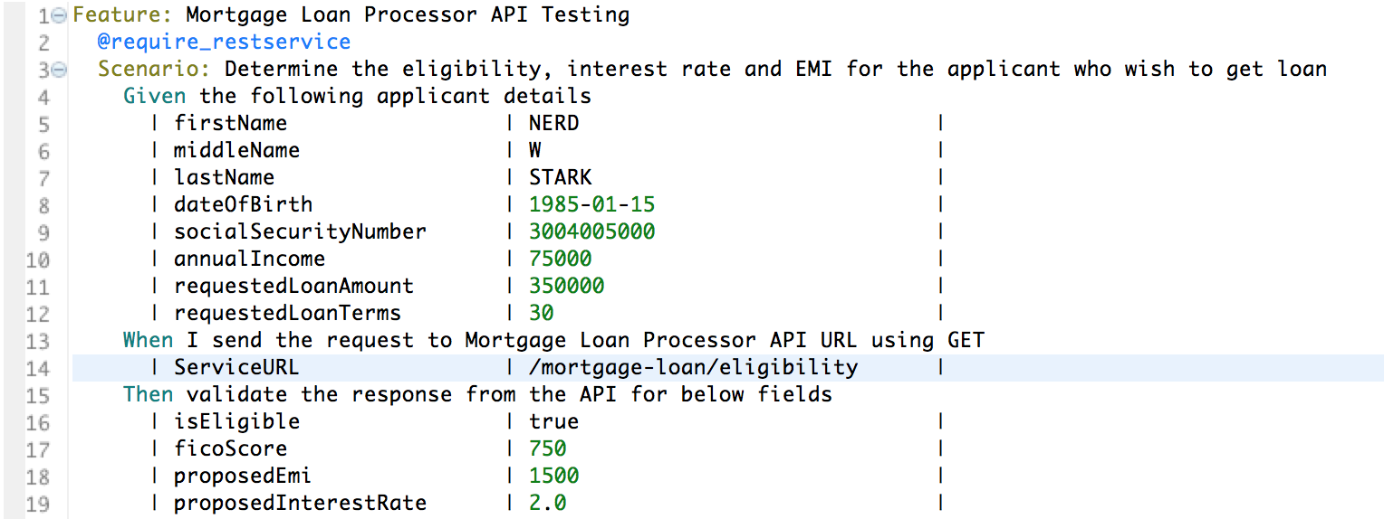
Cucumber – TYPICAL test code

Slide 16
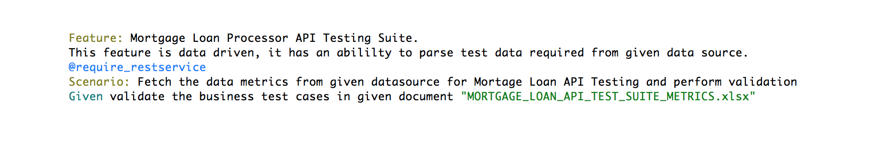
Data driven cucumber TEST CODE

Slide 17
BENEFITS OF THE TOOL
Intent owner can add test scenarios on the fly.
When new scenario is added, data is virtualized automatically.
No dependency on application team to add/modify test data.

Slide 18
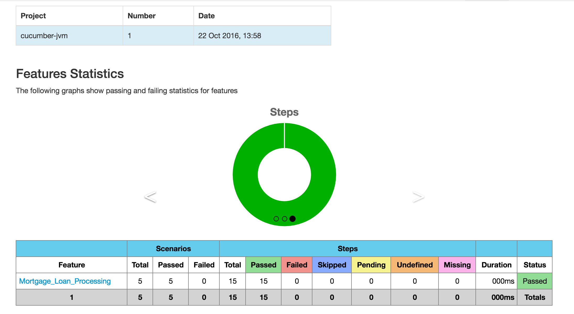
Benefits of the tool
Send test results to end user and archive it for future reference/compliance.
Ability for end user to approve releases based on test results.

Slide 19
Benefits of the tool
Easy integration with CICD
Creates a comprehensive regression test suite.
Faster testing = Faster time to market.

Slide 20
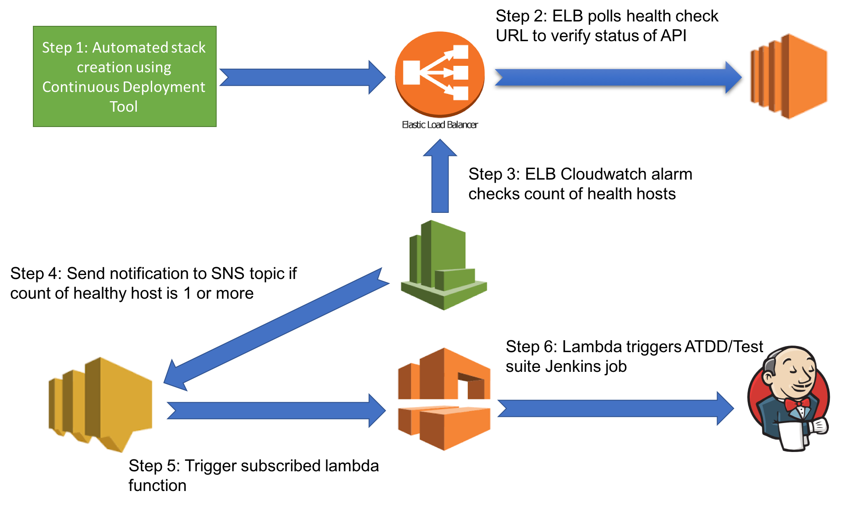
CICD Pipeline

Slide 21
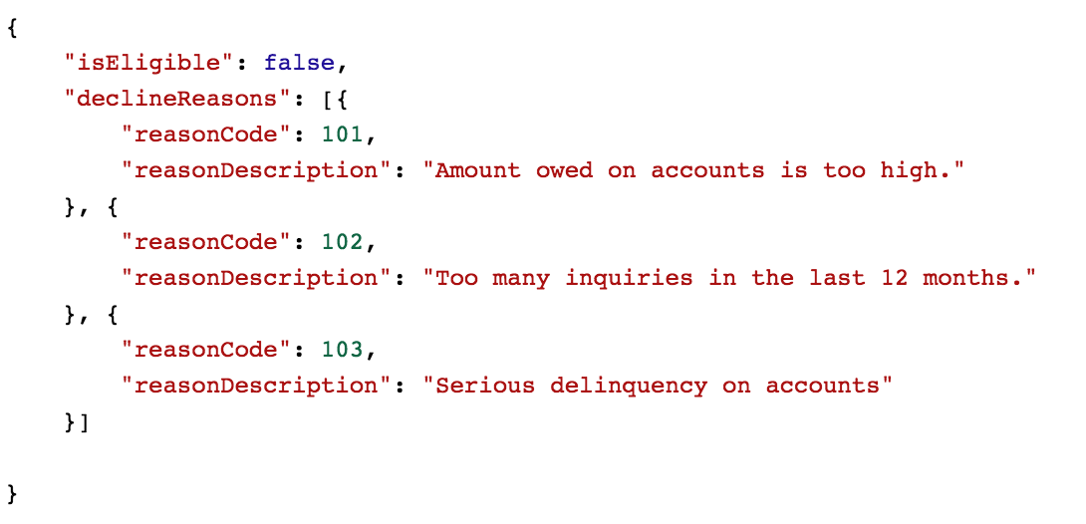
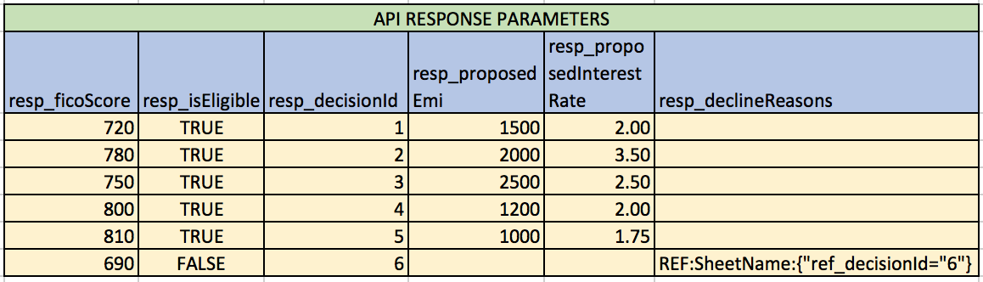
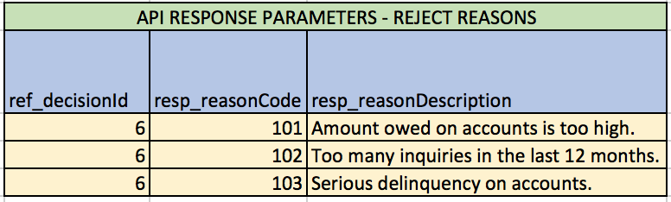
Challenges encountered
Writing generic parser for fetching test metrics from Spreadsheet
Resolving hierarchical relationship between data elements

Slide 22
Challenges encountered
JSON Response validation expected vs actual
Making cucumber html report without scenario for each test case

Slide 23
use case for demo
API to calculate mortgage loan eligibility
Calls external API to get credit score from Trans Union /Equifax
Calls backend API to calculate loan rate
Credit Report API
Client
Mortgage Loan API
Loan Rate Calculator API

Slide 24
Demo

Slide 25
Questions?

Slide 26
Reference material
Reference code location:
https://github.com/dironman/mortgageloanprocessor
Contact us:
https://www.linkedin.com/in/ameya-sukthankar-665baa54
https://www.linkedin.com/in/aboutmahesh
https://www.linkedin.com/in/deepak-kumar-soni-52244322

